Slide 1
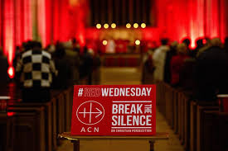
Our students in Divinity were invited by ACN to take part in two promotional videos; one for Red Wednesday 21st November 2024 and one for ACN UK with Mustard Seeds which will be used in Catholic schools up and down the country.

Slide 8
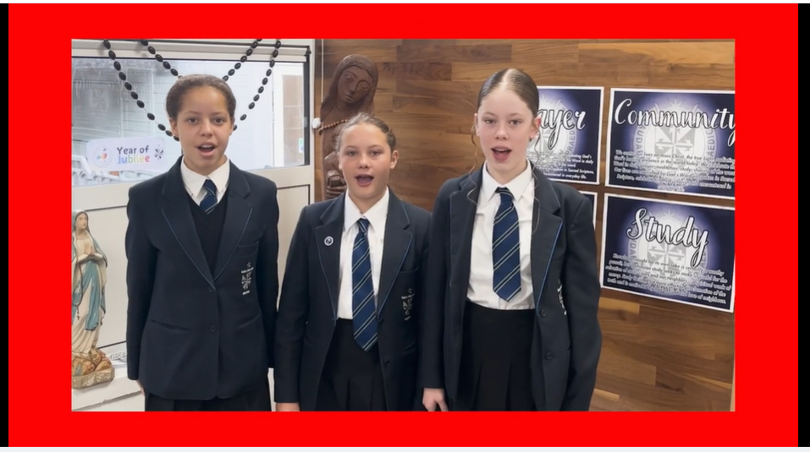

Slide 9
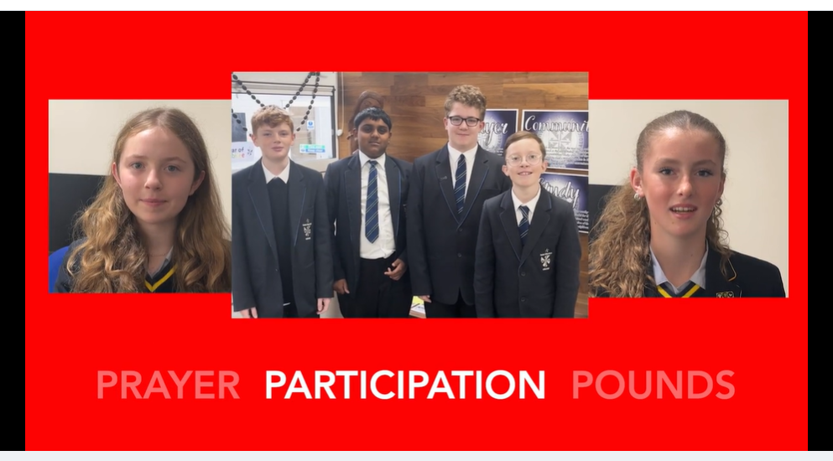

Slide 12
