Slide 1
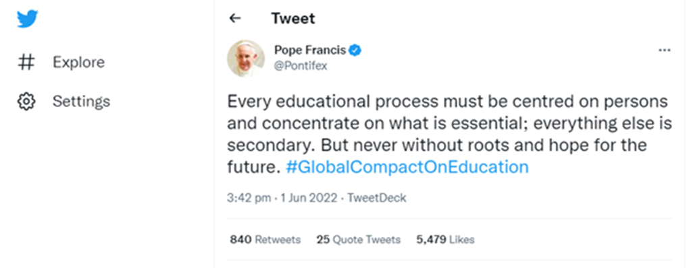
A warm welcome to you all from the family of Saint Martin’s Catholic Academy.

Slide 3
Collaboration with our Diocese
What is God calling you to do?
https://www.youtube.com/watch?v=khz47up7uzs&t=62s

Slide 4
Divinity and Chaplaincy collaboration with Lucy Chapman and Alex Shelton-Bourke

Slide 5
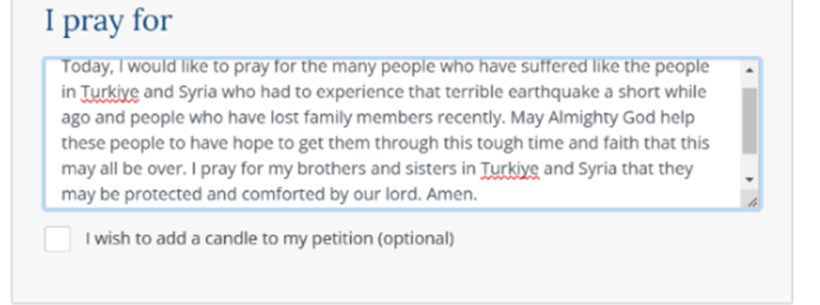
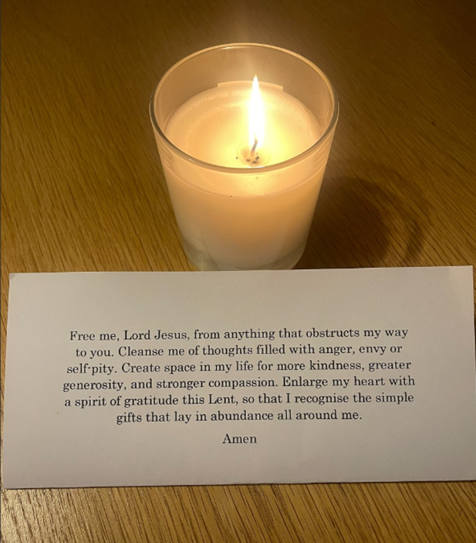
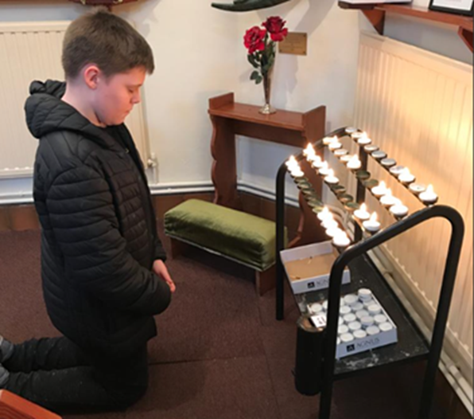
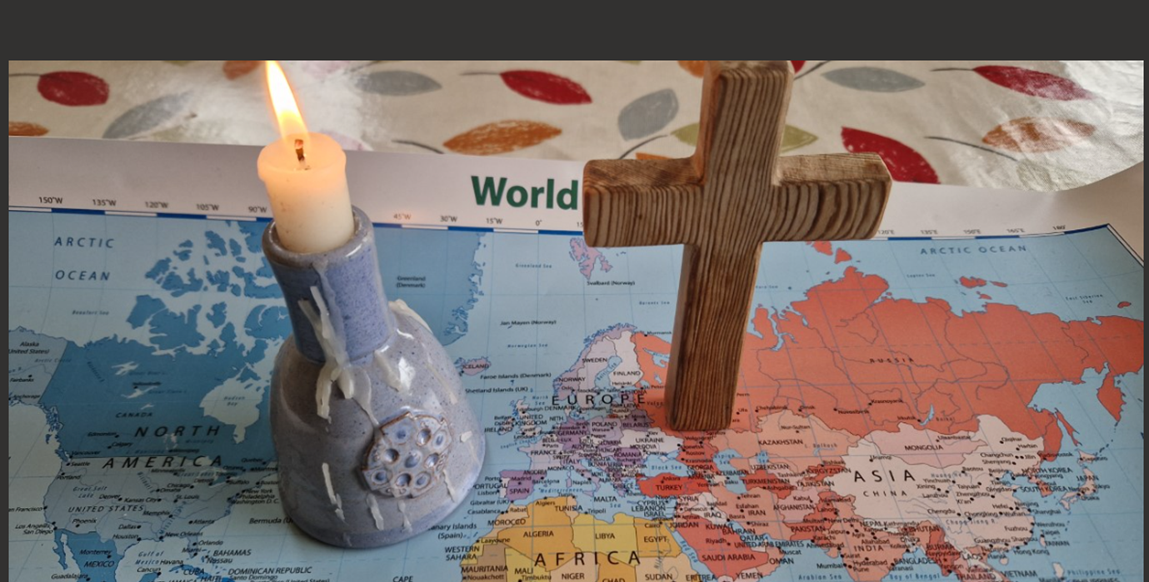
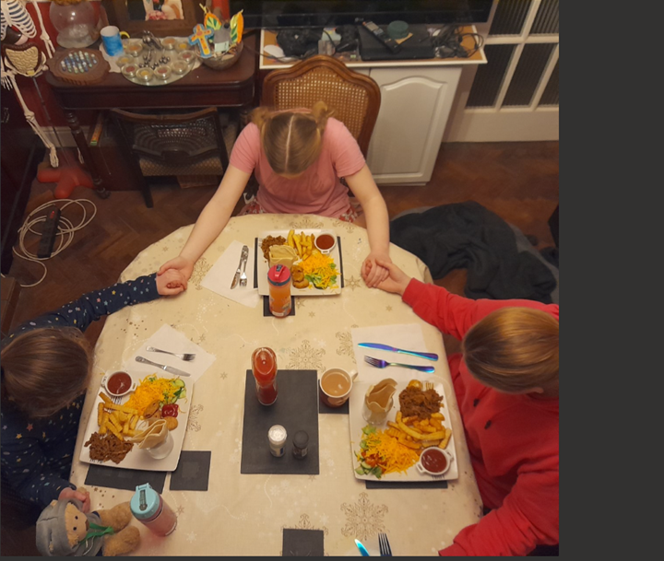
Our Prayers for Lent 2023

Slide 6
Collaboration with Missio
https://missio.org.uk/the-hail-mary-in-ten-languages/
Sent: 20 May 2021 10:16
To: Lucy Chapman
Subject: RE: Saint Martin’s Hail Mary in Spanish
Dear Lucy,
Wow! Your students! These are wonderful. Thank you.
We have more than enough to create a decade. But to complete the decade properly, maybe you could supply the Our Father or have a few students say it together with you?
We are delighted with these, and as your Pentecost film displays, they are a brilliant representation of our Universal Church – and a wonderful showcase of your school’s fantastic languages department and international community. I’m sure the Catholic Education Service and your own Diocesan Education Department would love your Pentecost film 😊
Give us a couple of days to put a Mission Together twist on the recordings and we’ll share what we’ve created on our Missio and Mission Together websites and social media.
Thank you for letting us employ these recordings. They are perfect for Missio and Mission Together.
God Bless,

Slide 7
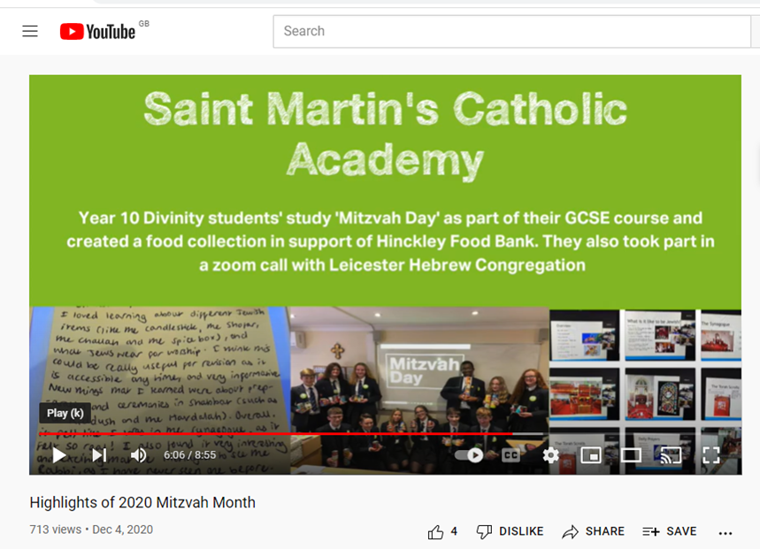
Collaboration with CEO of Mitzvah Month and Aid to the Church in Need

Slide 9
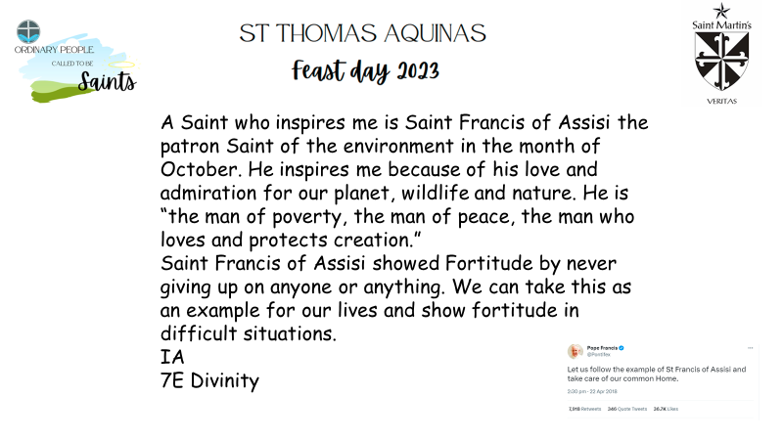
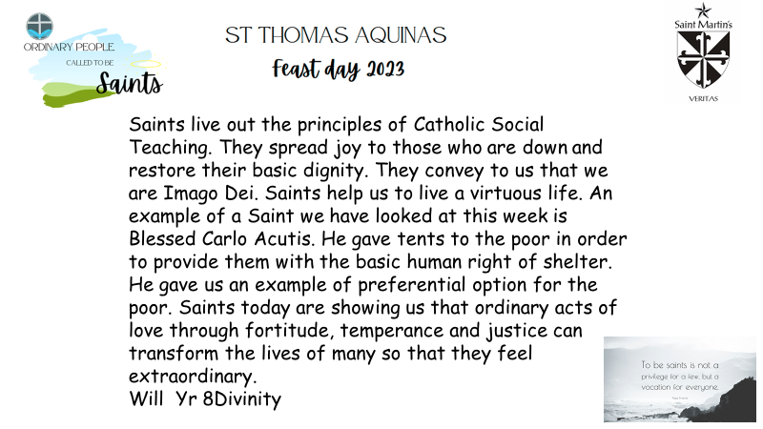
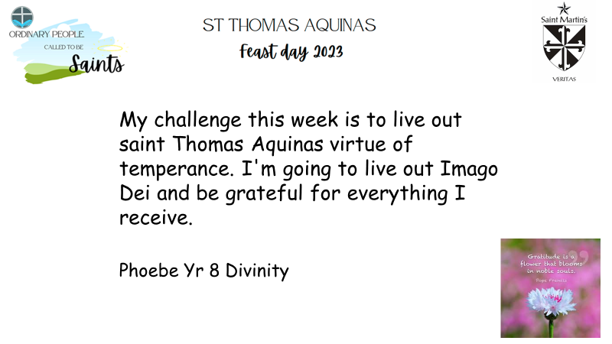
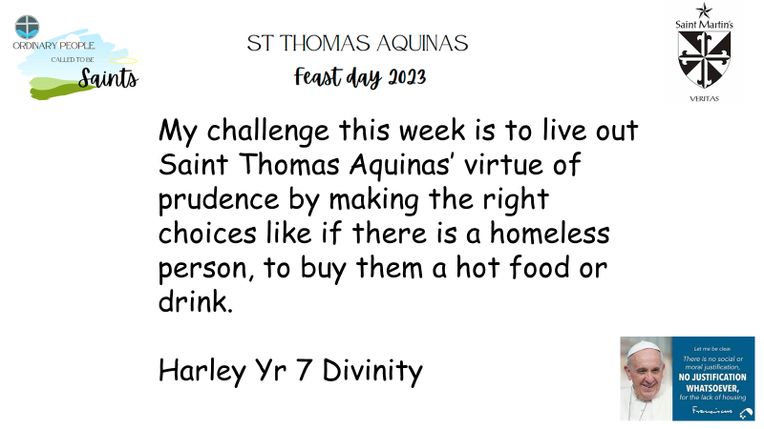
Collaboration with our CMAT
https://www.youtube.com/watch?v=geGV59GaC14

Slide 10
Collaboration with Cafod

Slide 11
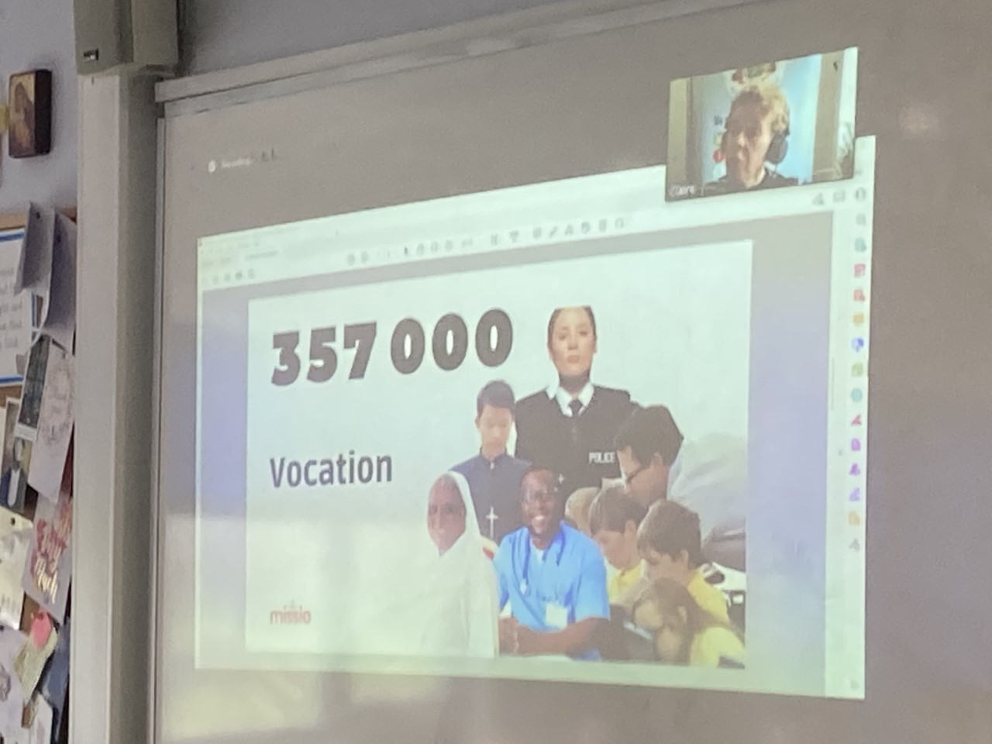
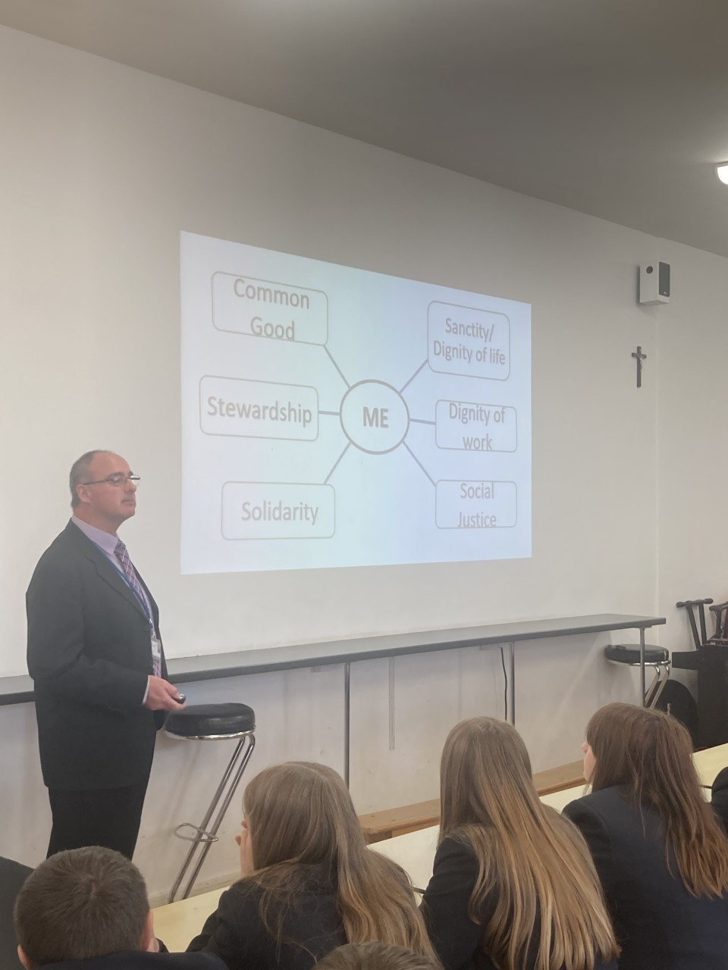
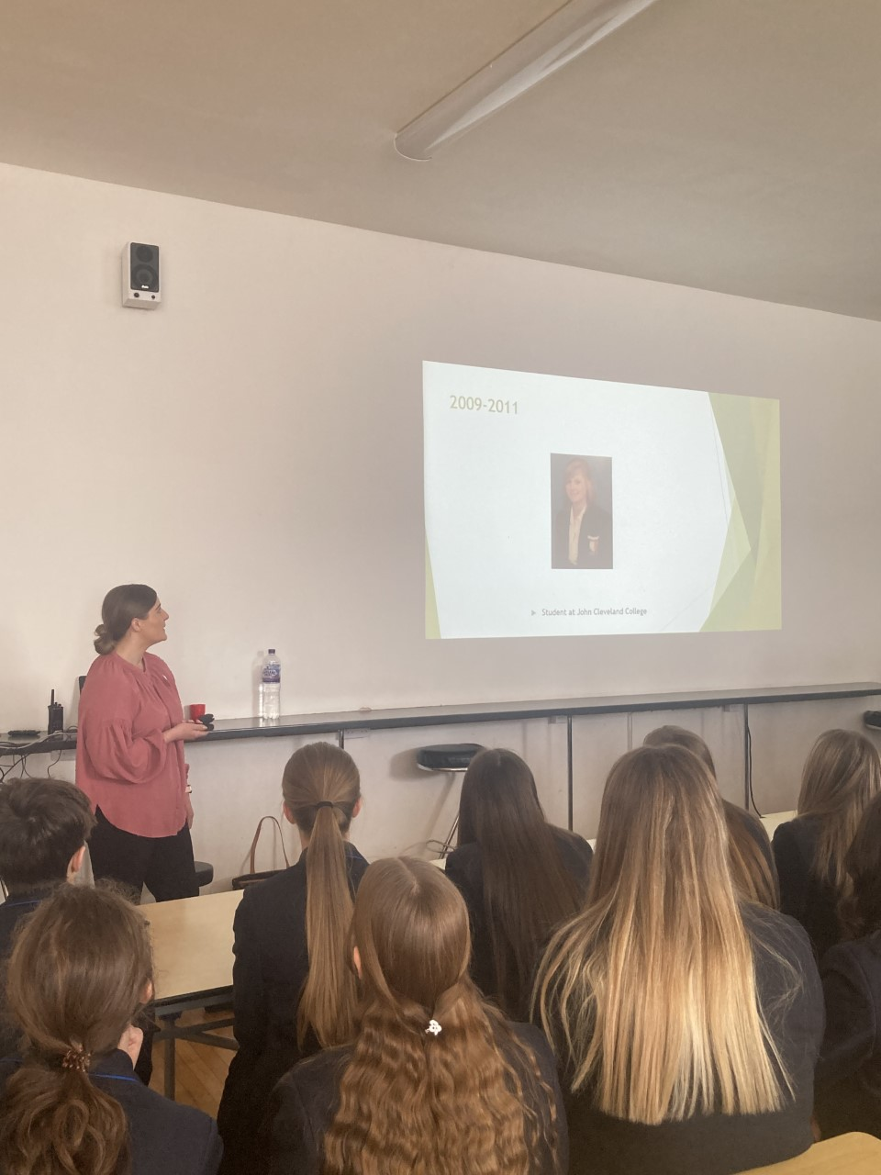
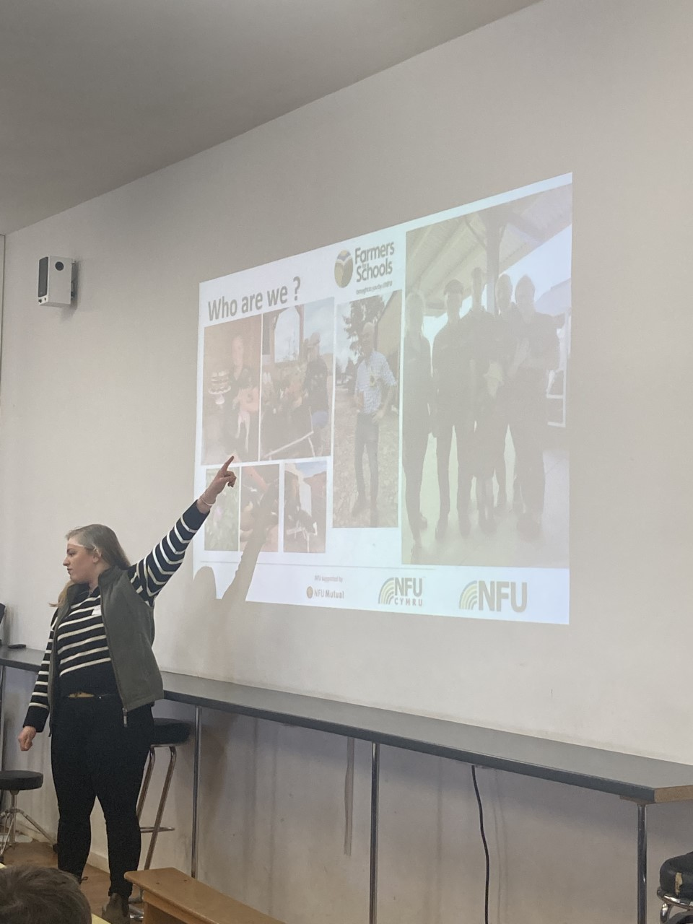
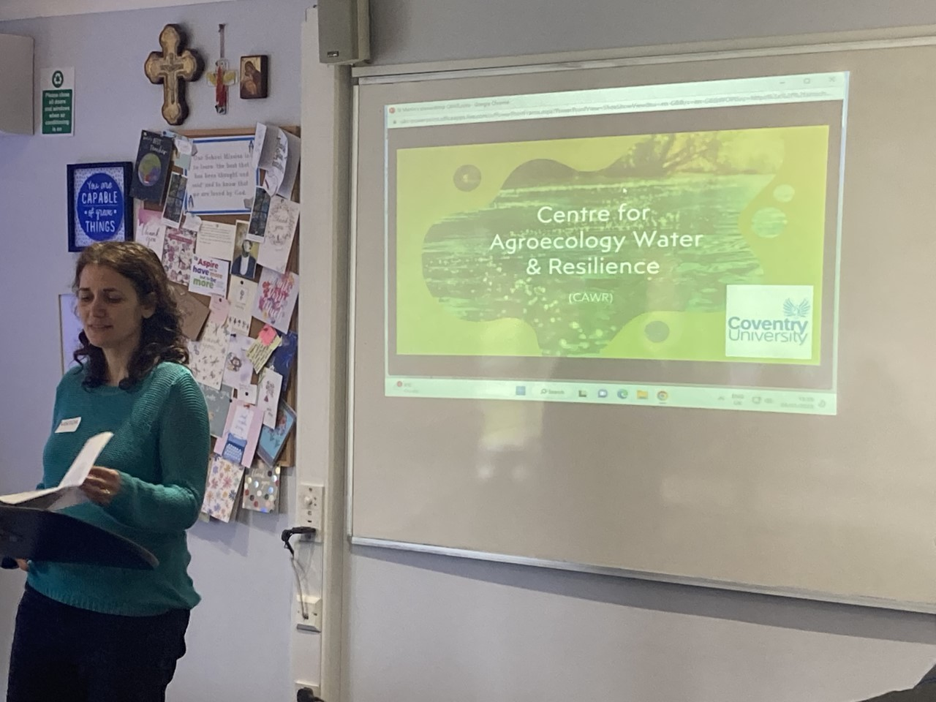
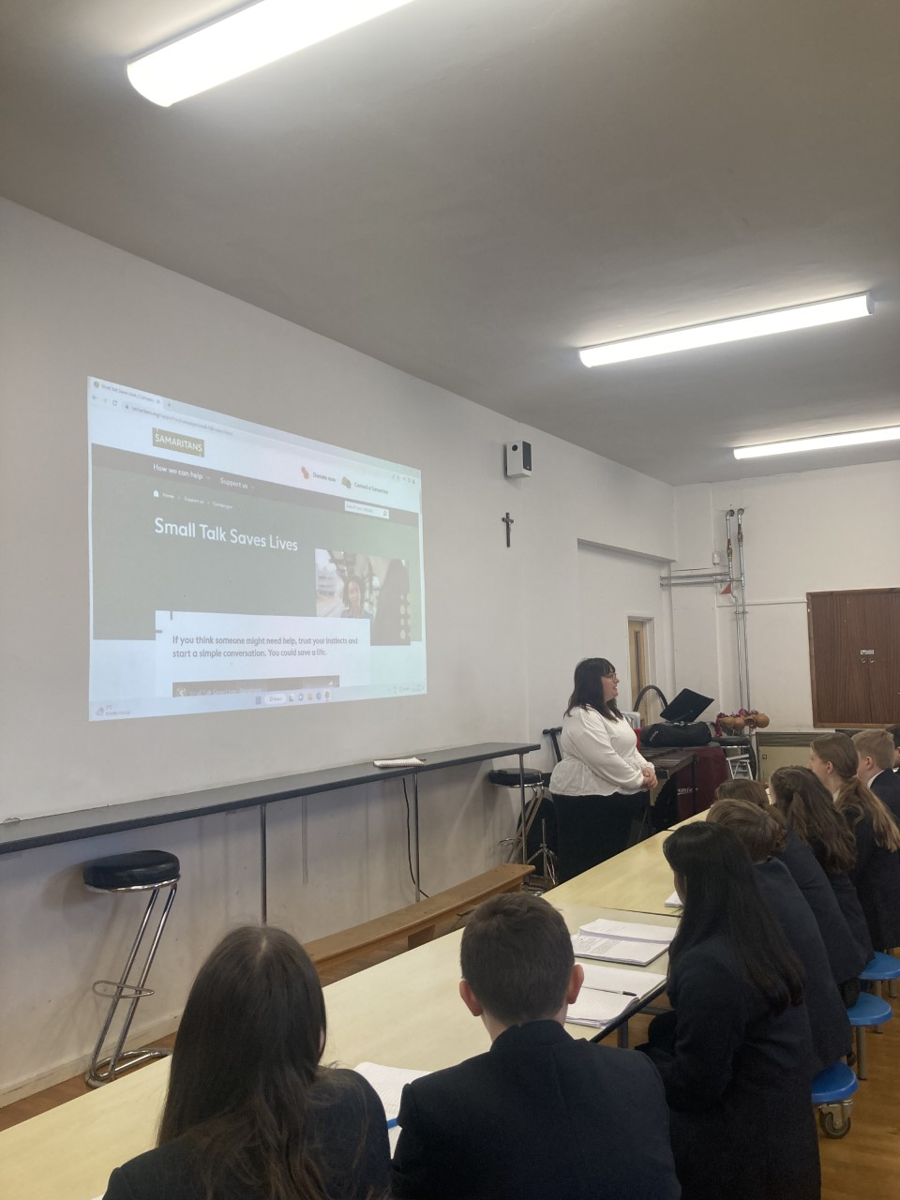
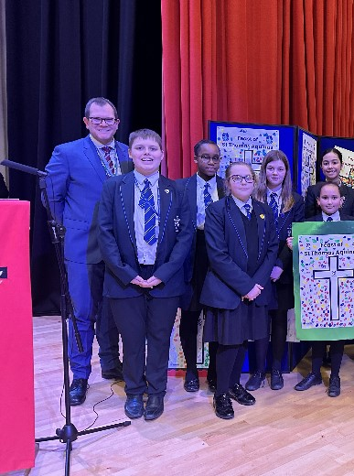
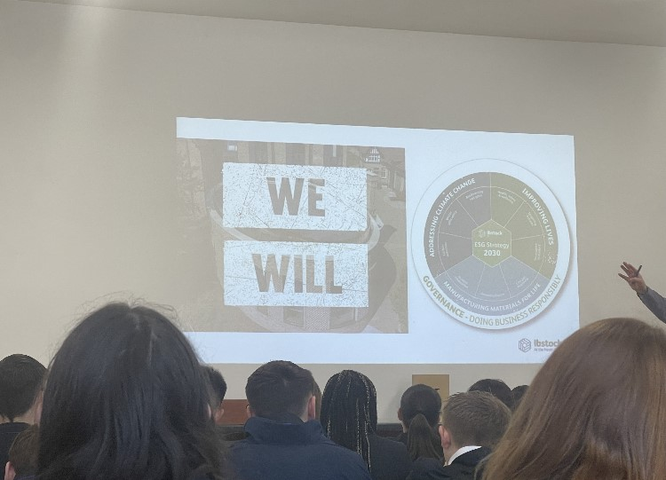
Divinity Careers week 6th-10th March 2023 linked to CST and our Virtues

Slide 12
*Dear Father Dave,
Thank you for spending your time to come and talk to us about your career. You have inspired many people to become better versions of ourselves and shared your favourite virtues and most inspiring Bible characters. This has helped me to more deeply think about what the virtues really mean and how I can include them in my daily life.
Sincerely Grace.
*To Father David,
We at Saint Martins are all very thankful for you coming in and talking to us about your faith journey so far. Your messages were incredibly inspiring and will inspire many of us to live out our lives to the full. Thanks again for coming in and spending your time talking to us. From Saint Martin's Catholic Voluntary Academy
*Thank you Father Dave for your inspiring talk. You have inspired us to be the best versions of ourselves and Imago Dei. We are very grateful to have had you come into our school to inspire us and tell us about your journey to becoming a priest.
Learner Voice from our students

Slide 13
