Slide 1
Pilgrims of Hope Careers Week in Divinity March 3rd-7th March 2025 to coincide with Pope Francis’ message for Lent and International Women's Day
We are very grateful to our parents/carers and visitors for giving so generously of their time to show how we can be Pilgrims of Hope through their journeys and field of work in our Jubilee Year and how this can link to the principles of Catholic Social Teaching: Imago Dei Dignity and Sanctity of human life, Common Good, Solidarity, Subsidiarity, Social Justice, Dignity of workers, Stewardship.
We continued to look at the importance of Interfaith Dialogue through the work of Mitzvah Day, ACN (Aid to the Church in Need) Missio and CARJ (Catholic Association for Racial Justice)

Slide 2
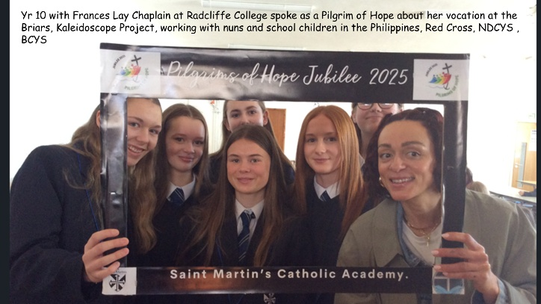

Slide 4
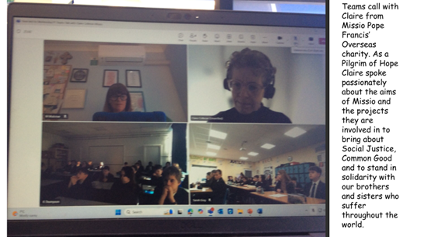

Slide 7
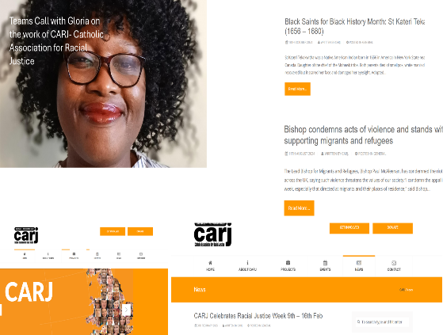

Slide 9
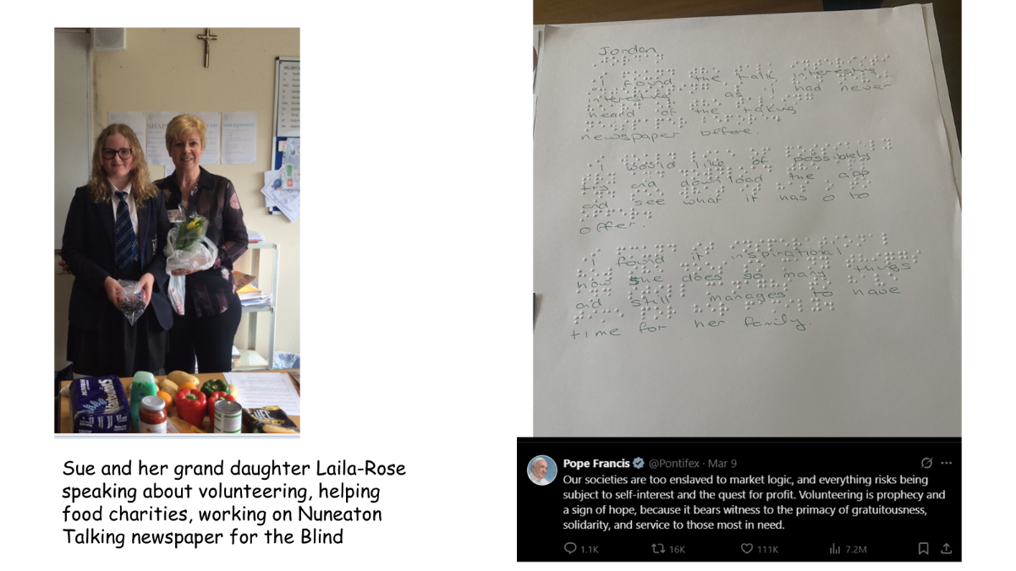

Slide 10
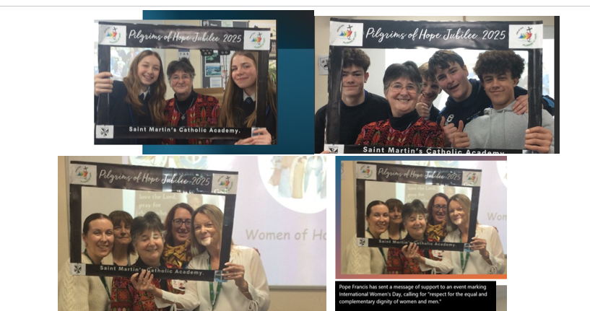

Slide 12
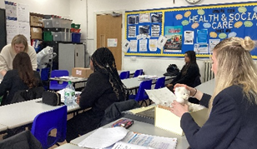
Thank you to Amy press officer from ACN for speaking about her role in compiling national reports for policy documents for those who are persecuted for their faith around the world and for the podcasts she produces and speaking about ways CAN supports projects for girls and education ahead of International Women’s Day.
Thank you to Rose Twigger for speaking to Year 11 Health and Social Care about her work as a midwife and bereavement counselling.

